Slide 1
SQL Bros Blog
“Sarah’s Thoughts”
Gage Gabaldon | Yin Yu Chen | Cole Bruton
Notes:
Gage

Slide 2
Expectations
Small company needing way to display blog posts to all visitors.
Owner also wants a separate ability to post certain pages that only they can edit/create.
Static pages
Does not want to write HTML.
Use of TinyMCE
Wants #hashtag tag abilities - along with search by tag(s).
User accounts to allow authorized users publish posts.
Admin approval of posts.
Scheduled publish and removal of posts… (WIP) - Finished
https://the-software-guild.s3.amazonaws.com/java-ddwa/v2.7-2010/cms-blog-specification.pdf
Notes:
Gge

Slide 3
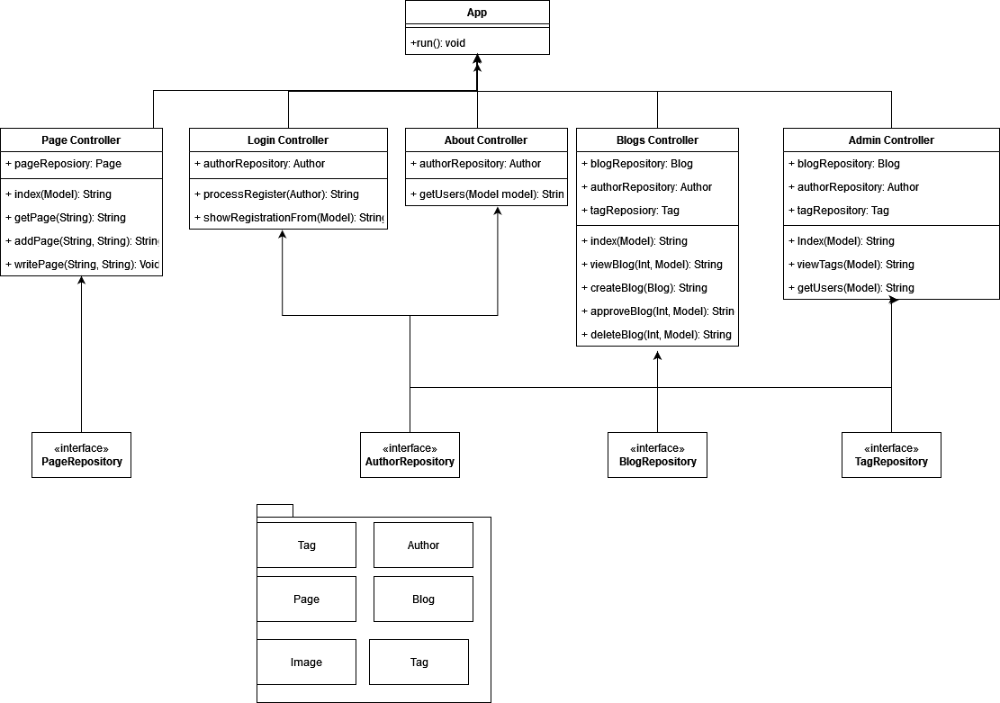
App UML
Notes:
Gage

Slide 4
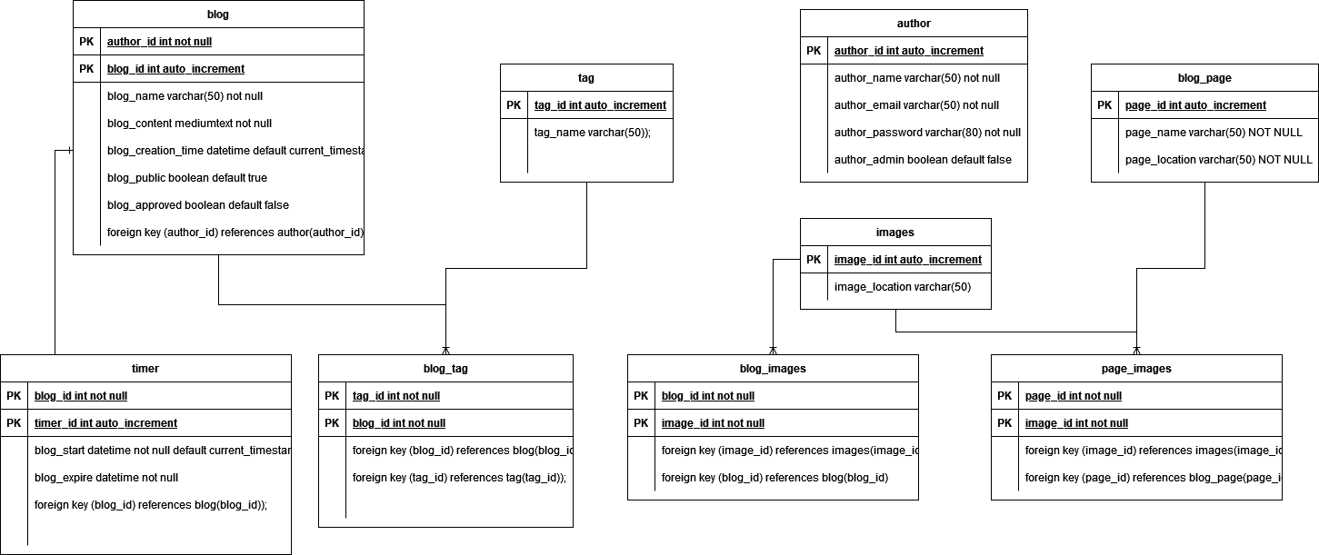
App ERD
Notes:
Gage

Slide 5
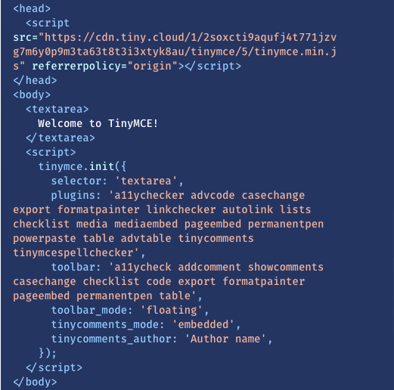
TinyMCE
Open source Rich-text editor
Allows image placement and formatting of text.
Publish written content to HTML format
No need for knowledge of HTML
Freemium app with API key
Works with many commonly used libraries and Frameworks.
https://www.tiny.cloud

Slide 6
HTML
Creation of a boilerplate template that can be the basis for all pages.
Navigation bar at top with website Title and links
Footer at bottom with links to social media accounts.
All blog posts created through the TinyMCE will be added to blog page with same formatting.
Static pages created through TinyMCE will be created and stored with added HTML formatting to match.

Slide 7
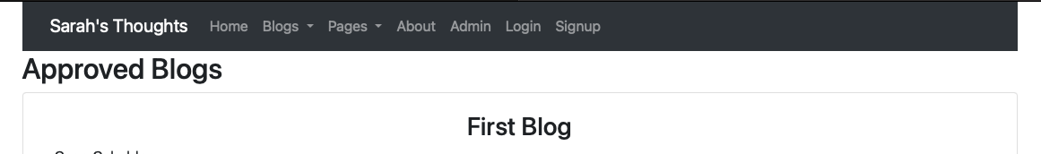
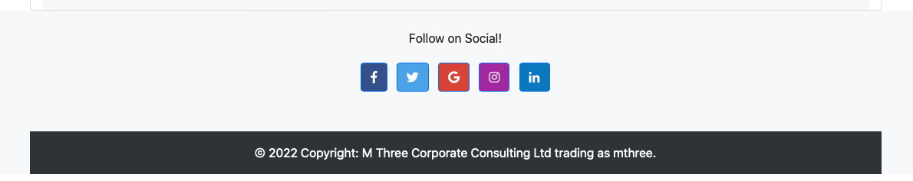
Notes:
Cole

Slide 8
HTML - Thymeleaf
Use of Thymeleaf in HTML to make calls to information stored in the models/database.
Also used to add created information to the models and database for storage.
Thymeleaf Attributes used within existing HTML tags.
Generally start with “th:” followed by the attribute.

Slide 9

Controller
The App is using Java with the spring framework to deliver the html web pages to the user.
Processes requests and redirects to appropriate website pages.
Individual controllers are used to process the GET and POST requests to the server.
Blog Controller for blog posts
Admin Controller for processing user accounts and admin processes
Login Controller for redirecting to proper page for login or account creation.
Static Controller for processing admin creations of non-editable pages.

Slide 10
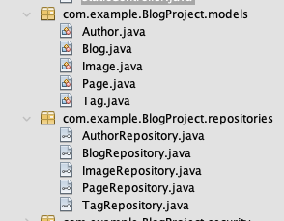
Model
Blog | Object used to store information about each blog created.
Image | Object to store image information
Tag | References each tag and blogs that are linked.
Author | All the information regarding the author
Page | Used for the static pages that only the owner can create.

Slide 11
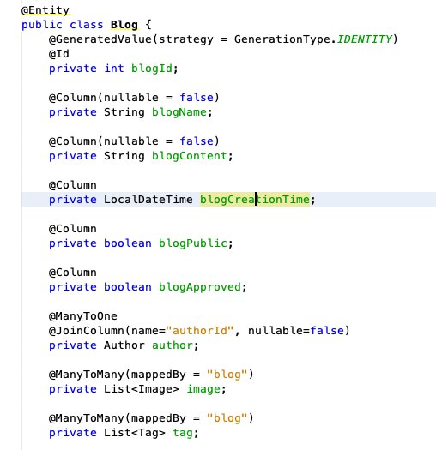
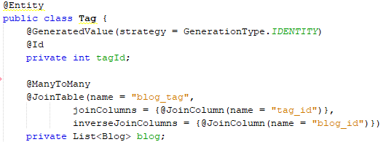
Model
Each of the classes contains a basic setup like this.
Use of annotations equates the entities and variables to their corresponding tables in the database.
Each model has a Repository class for interacting with the database itself.

Slide 12
MySql aka backend
Database implementation for long term storage of data.
Data stored in Model objects is sent to database.
JPA implementation using annotations.
Removed the need for SQL statements.
JDBC Template

Slide 13
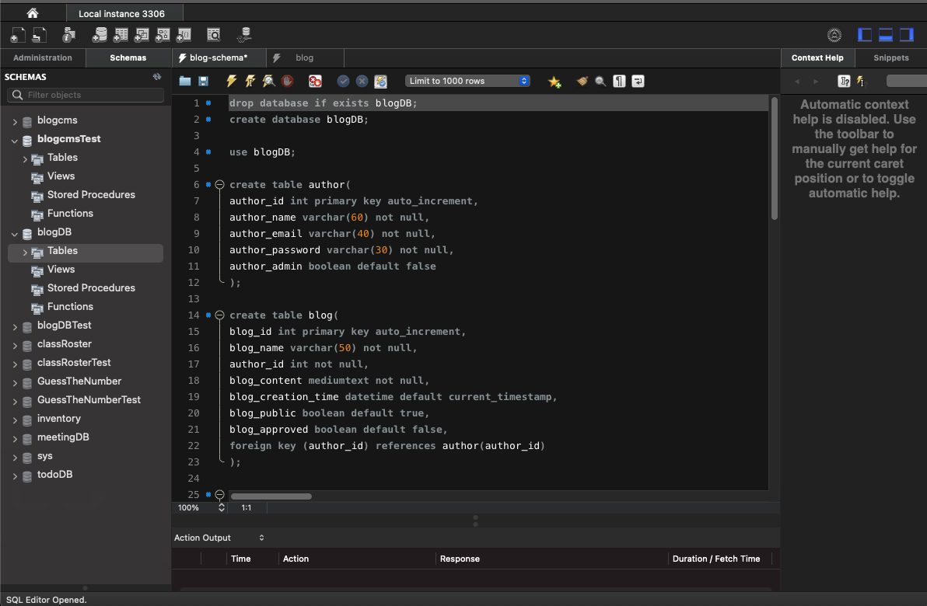
MySQL Workbench

Slide 14
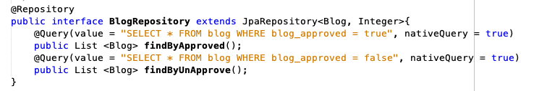
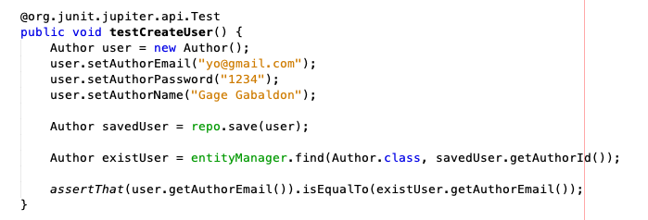
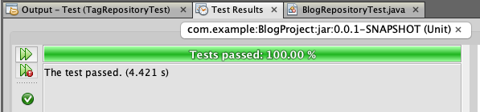
Testing
Spring testing with junit
Testing of the repositories and simple functions.

Slide 15
The End

Slide 16
Live Demo
Notes:
Gage

